Slide 1
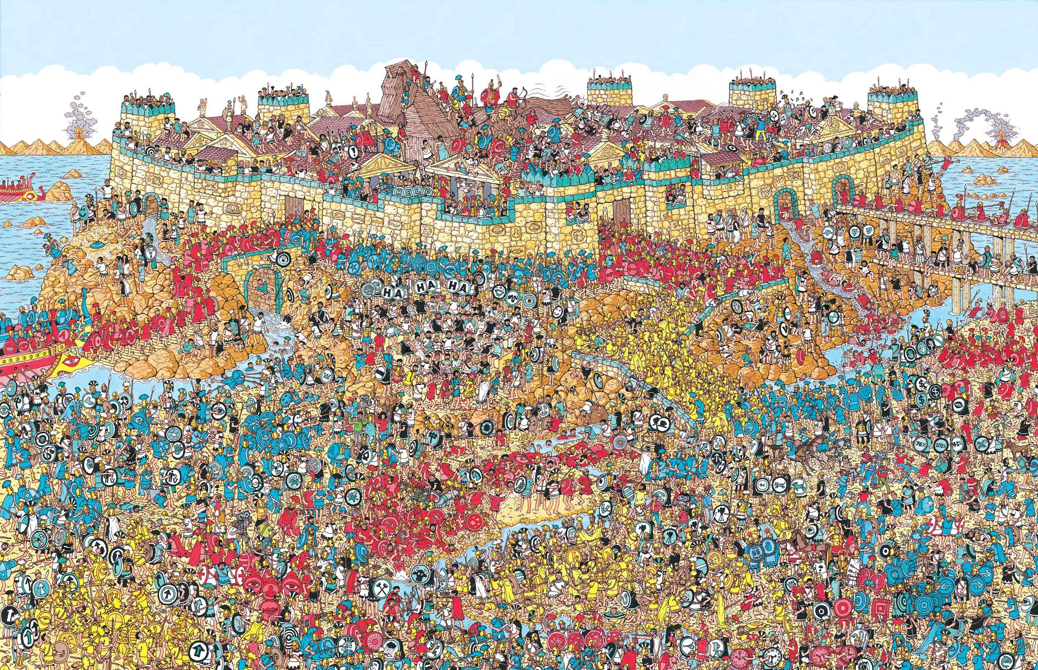
Where’s Waldo
… Solved by a computer

Slide 2
Dataset
our own Dataset
400 Waldos 1000 Non Waldos
Picture size too big (200 x 200 px)
Dataset from the internet
Very few Waldos
Sometimes Waldo is cut in half
Some wrong Waldos
Our own Dataset 2.0
Based on the Dataset from the internet
More good Waldos, less bad Waldos

Slide 3
Model

Slide 4
Results

Slide 5
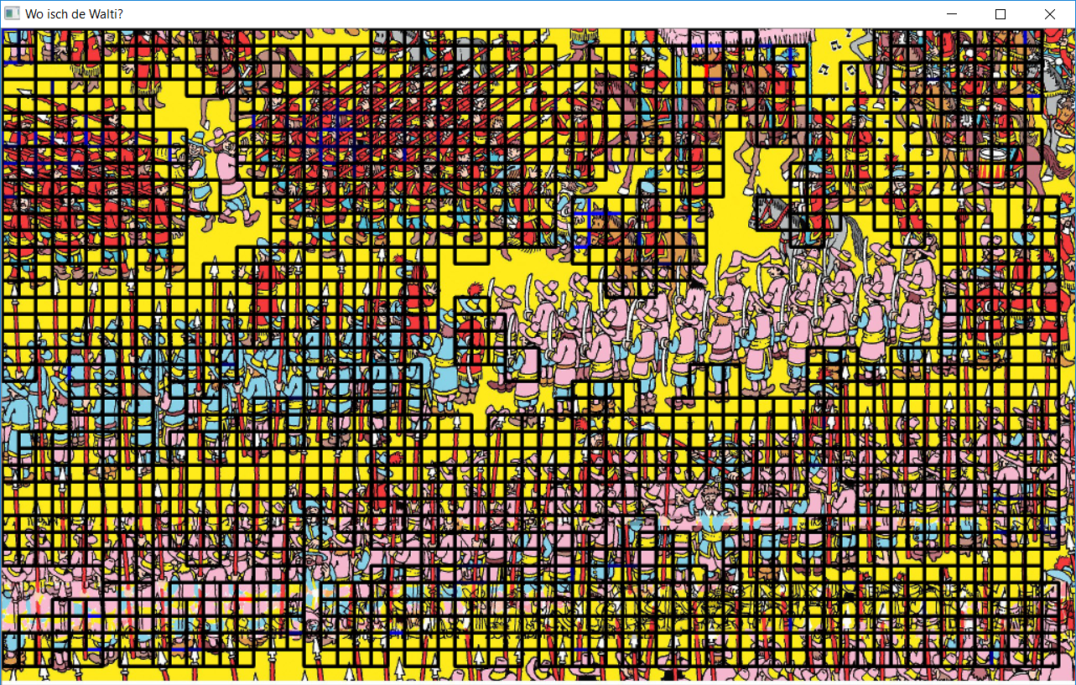
Results

